Slide 1
Enhanced Operating System Security Through Efficient and Fine-grained Address Space Randomization Author: Cristiano Giuffrida
CS 5352: Advanced Operating Systems Design Ravi Sankar Gogineni

Slide 2
Overview
Introduction
Kernel-level Exploitation
Existing Solution
Address Space Randomization (Challenges & Design)
Architecture
ASR Transformations
ASR Performance
Related work
Summary & Conclusion
References

Slide 3
Introduction
the deployment of many application level countermeasures against memory errors and the increasing number of vulnerabilities discovered in the kernel has fostered a renewed interest in kernel-level exploitation.
the first design for fine-grained address space randomization (ASR) inside the operating system (OS), providing an efficient and comprehensive countermeasure against classic and emerging attacks, such as return-oriented programming

Slide 4
Kernel-level Exploitation
Kernel-level exploitation increasingly gaining momentum.
Many exploits available for Windows, Linux, BSD, Mac OS X, iOS.
Plenty of memory error vulnerabilities to choose from.
Plethora of internet-connected users running the same kernel version.
Many attack opportunities for both local and remote exploits.

Slide 5
Existing Solution
Preserving kernel code integrity
Kernel hook protection
Control-flow integrity
No comprehensive memory error protection
Virtualization support required, high overhead.

Slide 6
Address Space Randomization
Well-established defense mechanism against memory error exploits.
Application-level support in all the major operating systems.
system itself The operating typically not randomized at all.
Only recent Windows releases perform basic text randomization.
Goal: Fine-grained ASR for operating systems.

Slide 7
Challenges in OS-Level ASR
Instrumentation
Re-randomization
Information Leakage
Brute forcing

Slide 8
A Design in OS-Level ASR
Make both location and layout of memory objects unpredictable.
LLVM-based link-time transformations for safe and efficient ASR.
Minimal amount of untrusted code exposed to the runtime.
Live rerandomization to maximize unobservability of the system.
No changes in the software distribution model.

Slide 9
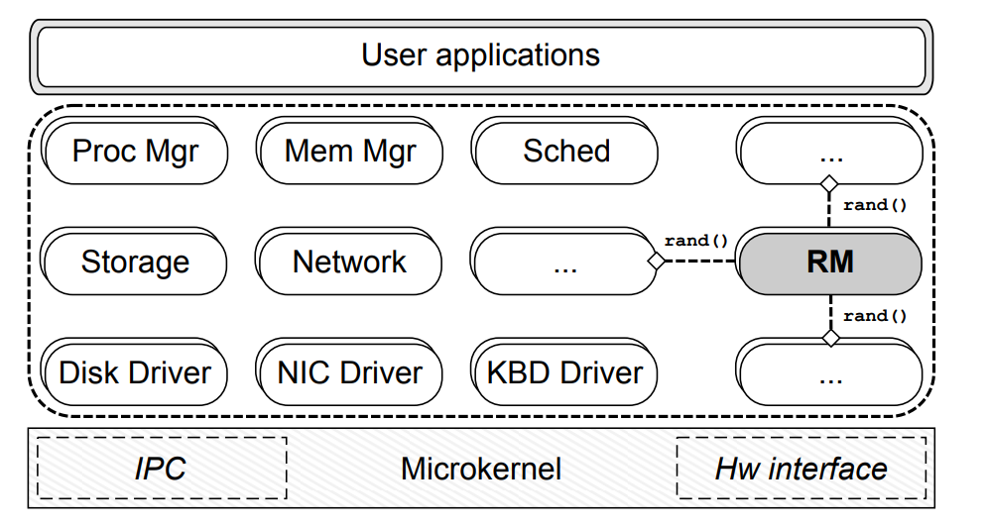
Architecture

Slide 10
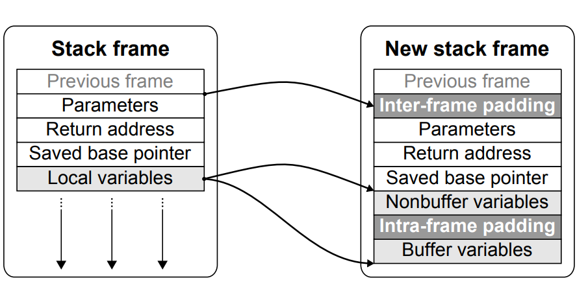
ASR Transformations
Stack Randomization

Slide 11
Code Randomization
The code-transformation pass performs three primary tasks.
It enforces a random permutation of all the program functions.
It introduces (configurable) random-sized padding before the first function and between any two functions in the bit-code, making the layout even more unpredictable.
unlike existing ASR solutions, we randomize the internal layout of every function.

Slide 12
Static data randomization
The data-transformation pass randomly permutes all the static variables and read only data on the symbol table, as done before for functions.
Buffer variables are also separated from other variables to limit the power of buffer overflows.
The order of the elements in an array cannot be easily randomized without changing large portions of the code and resorting to complex program analysis techniques that would still fail in the general case

Slide 13
Dynamic Data Randomization
Support for malloc()/mmap()-like allocator abstractions.
Memory mapped regions are fully randomized.
Heap allocations are interleaved with random-sized padding.
Full heap randomization enforced at live re-randomization time.
ILR for all the dynamically allocated memory objects.

Slide 14
Live Rerandomization
First state-full live re-randomization technique.
Periodically re-randomize the memory address space layout.
Support arbitrary memory layout changes at re-randomization time.
Support all the standard C idioms with minimal manual effort.
Sandbox the re-randomization code to recover from run-time errors.

Slide 15
ASSR Metadata
Types
Global variables
Static variables
String constants
Functions
Dynamic memory allocations

Slide 16
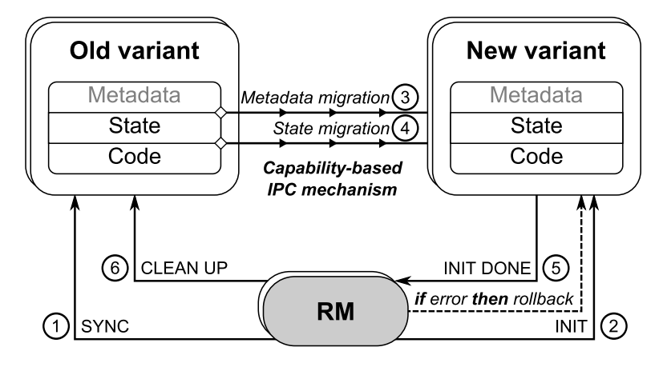
ASRR Transformations

Slide 17
State Migration:
The migration starts by transferring all the metadata from old variant to a local cache in the new variant.
To automate the metadata transfer all the data structures copied use a fixed and predetermined layout.
The mapping phase generates all the perfect pairs of state objects in the two variants, ready for data migration.
Pointer Migration:
The C programming language allows several programming constructs that make pointer migration particularly challenging in the general case.
Fully automate migration of all the common cases and only delegate the undecidable cases to the programmer.
Memory addresses or other layout-specific information may be occasionally stored in integer variables

Slide 18
Evaluation
We have implemented our ASR design on the MINIX 3 microkernel-based operating system [32], which already guarantees process-based isolation for all the core operating system components.
The OS is x86-based and exposes a complete POSIX interface to user applications.
The resulting operating system comprises a total of 20 OS processes including process management, memory management, storage and network stack.

Slide 19
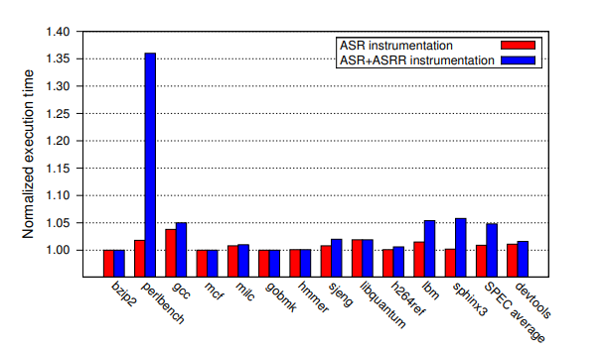
ASR Performance

Slide 20
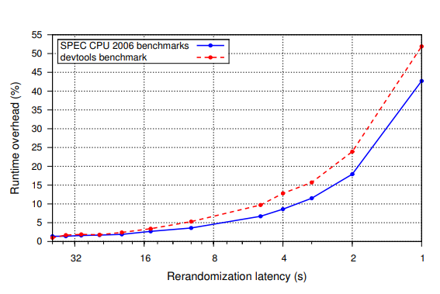
ASRR Performance

Slide 21
Effectiveness
As pointed out in , an analytical analysis is more general and effective than empirical evaluation in measuring the effectiveness of ASR.
The effectiveness of ASR techniques against guessing and brute-force attacks. These attacks are far less attractive inside the operating system.
The internal layout randomization provides better protection, forcing the attacker to learn the relative distance/alignment between two memory elements in the general case.
This technique constraints attacks based on arbitrary memory reads/writes to learn the address of the target element.
ASR design can also be used as the first “live-workaround” system for security vulnerabilities.

Slide 22
Related Work
The work on ASR focuses on randomizing the memory layout of user programs, with solutions based on kernel support , linker support , compiler-based techniques, and binary rewriting.
A number of studies have investigated attacks against poorly-randomized programs, including brute forcing , partial pointer overwrites , and return-oriented programming.
Our ASR design is more fine-grained than existing techniques and robust against these attacks and information leakage.
ASR design generalizes this strategy to the internal layout of any memory object (including code) and also allows live layout Re-randomization

Slide 23
Summary
A new fine-grained ASR technique for operating systems.
Better performance and security than prior ASR solutions.
Live rerandomization and ILR to counter information leakage.
No heavyweight instrumentation exposed to the runtime.
Process-based isolation to recover from run-time ASRR errors.

Slide 24
Conclusion
The first ASR design for operating systems to fully explore the design space, we presented an analysis of the different constraints and attack models inside the OS, while highlighting the challenges of OS-level ASR.
The technique can also be applied to generic user programs, improving existing application-level techniques in terms of both performance and security, and opening up opportunities for third-generation ASR systems.
This strategy is more portable and much safer than existing techniques, which either rely on complex binary rewriting or require a substantial amount of untrusted code exposed to the runtime.
In this technique, the complex re-randomization code runs completely sandboxed and any unexpected run-time error has no impact on normal execution.

Slide 25
References
Research paper: https://www.usenix.org/system/files/conference/usenixsecurity12/sec12-final181.pdf
ASLR: leopard versus vista. http://blog. laconicsecurity.com/2008/01/aslr-leopard-versusvista.html
The story of a simple and dangerous kernel bug. http://butnotyet.tumblr.com/post/175132533/thestory-of-a-simple-and-dangerous-kernel-bug.

Slide 26
Thank You
ANY QUESTIONS ?

